Slide 1
Improv Technology for
Media Processor Applications

Slide 2
Improv “Crescendo” Media Processor - Product Overview
High performance, low power cores specifically designed for media processing
Combined Video, Audio and Image processing running in the same core significantly decreasing die size, power requirements and performance
Full product solution kits contain complete White Box implementation support including; custom processors, software and integration blocks for fast time to market cycles and drop-in implementation in your products
Support for a broad range of video, audio and image codec standards including H264/AVC, MPEG4, MPEG2 MP@ML, MP3, AAC, Dolby Digital™, Windows Media 9, DivX, Real, and JPEG image compression & decompression
Silicon-proven technology and firmware

Slide 3
Improv “Crescendo” Solution Kits
Crescendo is a family of solution kits highly optimized for media compression tasks
Broadcast-Quality Media Processors (BMP)
  High performance solutions for high-end (NTSC, PAL, HD) applications including set-top box, personal video recorders, consumer video equipment
  BMP Half-Duplex Codec
  BMP Decoder
Streaming Media Processors (SMP)
  Low power, die size and low clock rate solution for smaller (VGA, CIF, QCIF)
  SMP Full-Duplex Codec
  SMP Decoder
  SMP Audio

Slide 4
What’s in a Crescendo Media Processor Solution Kit?
Highly Optimized Media Processor Cores
  Custom processor cores created using the Improv’s Composer™ tools optimized for media processing
  Hardware accelerators and operations (DDCUs) for media processing tasks including IDCT, Motion, Huffman and Bit Handling acceleration
Software Suite with Complete Source Code Support
  Software modules for key media components
  Software framework including host API to interact with processor cores
SOC Integration Blocks
  Host Bus Interface - tight integration with AMBA-AHB (ARM) and other on-chip busses
  Data Channel Interface – Jazz-aware and media-aware DMA Controller
  Bit Stream FIFO

Slide 5
Media Codec & Application Module Support
H264 Baseline Decoder
  Full Main & Baseline Profile
MPEG4 - ASP Encoder
  Full D1 Resolution
MPEG4 - ASP Decoder
  Broadcast Quality video at D1
  Full ASP Implementation including ¼ pel, B frames, interlaced
MPEG4 - SP Codec
  Up to VGA sizes including error resiliency and data partitioning
Windows Media 9 Video Decoder
  Simple and Main Profiles
MPEG2 MP@ML Decoder
  Fully compliant implementation
Dolby Digital™ and Prologic™ Decoder
  Full surround sound or two channel sub-sampled
  Dolby Licensed implementation 5.1 & 7.1
  Only available to Dolby Licensees
MP3 Audio Decoder
  Complete implementation include 2.5 and LSR
AAC & AAC+V2 Audio
JPEG Image Codec
  JPEG Baseline and Progressive Images
  Motion JPEG Support
All modules delivered in source code so you can add your own algorithms (e.g., motion estimation)

Slide 6
Crescendo HW Acceleration – DDCUs for Media Processors
Custom H/W accelerators developed by Improv included within the Crescendo Solution Kits:
BitStream (12.5K)
  Reading and writing to/from bitstream buffer
BitStream w/Huffman Tables (25K)
  Same as above but includes loading and processing of Huffman tables for video; also reduces data memory requirements
DCT/IDCT (70K)
  Optimized datapath for DCT/IDCT operations
IDCT (55K)
  Optimized datapath for IDCT operations
SIMD Adder (3K)
  ALU optimized for video data widths and operations
H-Interpolator (30K)
  Interpolation and clipping operations
MP3 Table Accelerator (75K)
  Holds majority of MP3 Huffman tables and optimizes access; significantly reduces on-chip data memory requirements (over 3 sq. mm in 0.18).
GMC (15K)
  Optimizes key algorithms used in global motion compensation
Six Tap
  Six tap filter used in H.264 processing
Inverse 4x4 Transform
  Optimized for the H.264 4x4 transform
CABAC
  Acceleration of the CABAC processing in H.264
ADLU (5K)
  Speech processing accelerator

Slide 7
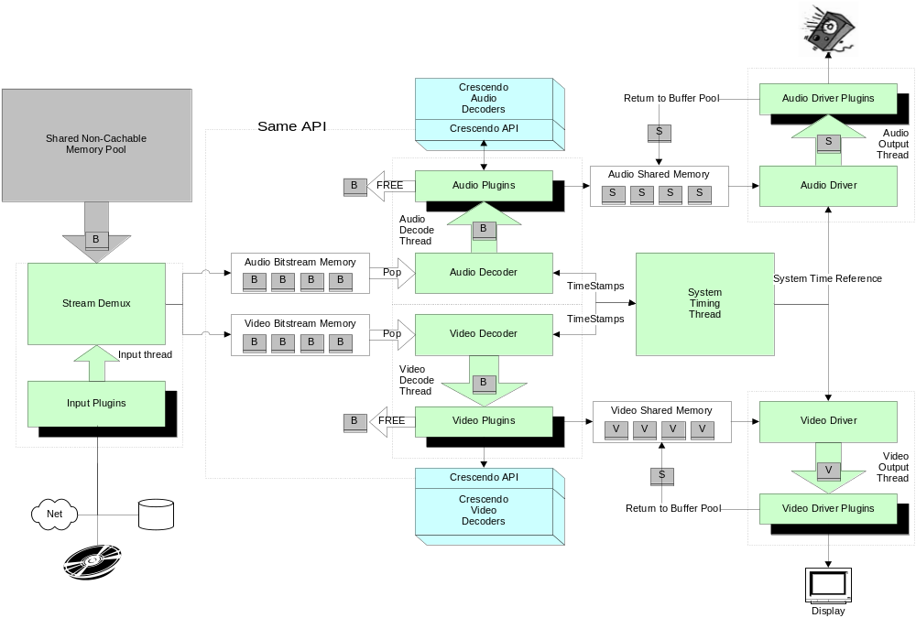
Crescendo Software Architecture (Decoder)

Slide 8
Crescendo BMP & SMP Processor Structure
BMP is a dual-processor architecture for high performance (e.g., D1) processing; SMP is a single processor for smaller frame applications
Intuitive API and HW Integration for communicating with a host processor
Media Framework allows up to four media channels at once
BMP supports direct interface to external memory; SMP uses system bus (e.g., AMBA) for data movement
Can be customized to match your memory subsystem including dedicated memory controller (pre-integration available for Denali Databahn)
Memory
Controller
JazzHBI
JazzDCITM
DM
DM
Crescendo
Main
Processor
DM
Crescendo
Transform
Processor
IM
IM
JazzHBI
DM
Crescendo
SMP
Processor
IM

Slide 9
Application Modules and Codecs for BMP & SMP
 | BMP Codec | BMP Decoder | SMP Codec | SMP Decoder | SMP Lite | SMP Audio
H264 Main Decoder
H264 Baseline Decoder
MPEG4 ASP Encoder
MPEG4 ASP Decoder
MPEG4 SP Codec
MPEG2 MP@ML Decoder
Dolby Digital™ and ProLogic™ Decoder
MP3 Audio Decoder
JPEG Codec
ü
ü
ü
ü
ü
ü
ü
ü
ü
ü
ü
ü
ü
ü
ü
ü
ü
ü
ü
ü
ü
ü
ü
ü
ü
ü
ü
ü
ü
ü

Slide 10
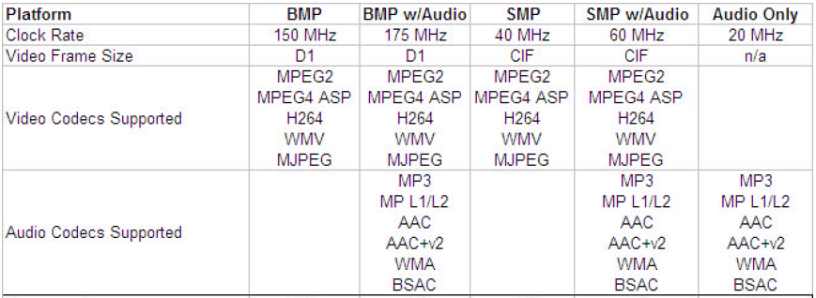
Crescendo BMP & SMP Platforms

Slide 11
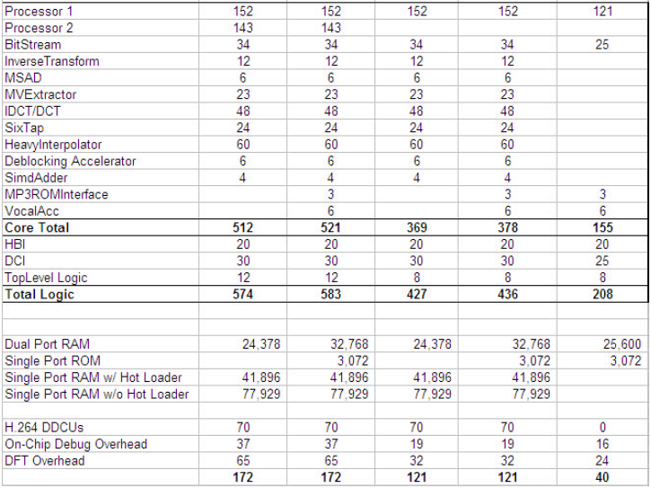
Crescendo BMP & SMP Platforms

Slide 12
SoC Integration Blocks
Crescendo Host Software Package
  ANSI-C compliant API for configuring, controlling and running all application modules in an integrated framework
  Supports up to 4 streams of data for video and audio
Host Bus Interface – Jazz HBI
  Hooks directly into host busses including AMBA™ AHB (ARM)
  Can be configured for different custom busses and Interface
  Mailbox-style interface for communicating with host processor
  Integrated Bitstream FIFO for media bitstreams
Data Channel Interface – Jazz DCI
  High-performance, “video aware” DMA for moving blocks of video data to and from memory
  Different configurations for different memory layouts of video data in memory
Bit Stream FIFO
  Efficient management and communication for loading the bit stream buffer

Slide 13
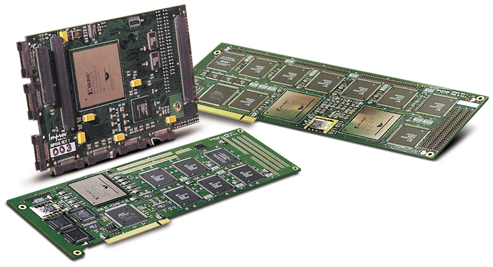
Improv Jazz PSA RehearsalTM Development Boards
Processor and System Verification
  Jazz PSA RehearsalTM XE2-6K
  Dual FPGA (2-4 processor)
  configuration; PCI-based
  Map “Composed” JazzTM processors onto FPGA technology, execute and test application code - includes full debugger support
  Use same test bench for functional, ISS and RehearsalTM board simulation
  Windows NT drivers – Multiple Configurations
Integrated Development Boards for RISC/DSP Development
  MIPS Malta Development Board integration

Slide 14
Improv CrescendoTM Media Processor Summary
Drop-in Solutions (HW and SW) for media processing applications including both decode and encode for Broadcast or Streaming Media
Small die size, low MHz requirement and low power compared to other industry implementations
Complete, shrink-wrapped implementations of leading media standards including H264/AVC, MPEG4, MPEG2, MP3, and Windows Media 9
Full Source Code (RTL and SW) to allow customization by your team to the specific needs of your product
Fully Programmable platform to extend product life, enhance differentiation and design reuse strategies

